Slide 1
UT-Assert Training
Charles Zogby
charles.a.zogby@nasa.gov
301-286-8541
9/2025 Modified by L. Prokop for Microair Avionics and accompanying demonstration software

Slide 2
Agenda
1.) UT-Assert Overview
2.) What’s Included in the UT-Assert Library
3.) Test Structure
a.) Flowchart
b.) Required Test Files
c.) Test Runner
i.) Adding Test Cases
ii.) Running Test Cases
d.) Setup / Teardown Functions
e.) Test Cases
4.) Writing Test Cases
a.) Structure
b.) Assert Statements
c.) Stub Functions
d.) Hook Functions
5.) Makefile
6.) Test Suite Execution
7.) Test Output
8.) Walkthrough: Example cFS Application Test Suite
9.) Walkthrough: Actual cFS Application Test Suite

Slide 3
UT-Assert Overview
Used for unit code through the use of assert statements
  An assert statement evaluates whether a condition is true or false and returns PASS or FAIL.
  Each test case should be self-verifying, rather than needing to be manually verified after running
Used to test functionality and code coverage of every function in an application, one at a time
  Each test should be completely independent from other tests
Each test case should test ONLY its designated function/operation
  Results of sub-functions do not need to be tested within that function but rather, tested in separate test case for each sub-function
Stub functions can/should be created for each sub-function (function called within a function) if control over that function behavior is necessary to test the designated function (will demo this)
  Tests can set individual stub functions to behave in 3 different ways:
    1.) Return its default return value
    2.) Return a specified custom value
    3.) Execute a specified custom hook function to return the hook functions return value
Hook functions can be created in addition to default “stub” function behavior if even more customized behavior is needed to fully test the function under test (this also will be demonstrated)

Slide 4
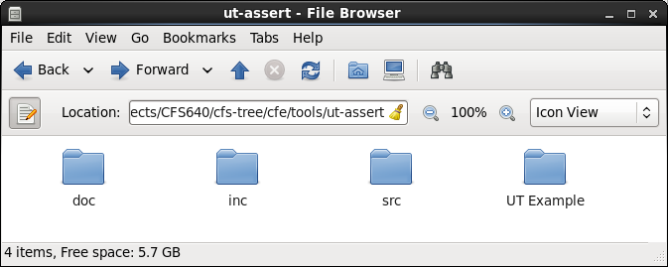
What’s Included in the Library
/src: Contains the library source files
/inc: Contains the header files for the library source files
/doc: Contains documentation about UT-Assert
  Note: current documentation is incomplete and outdated
    Will be replaced by this presentation
/UT Example: Contains an example UT-Assert unit test suite (and the app it tests)

Slide 5
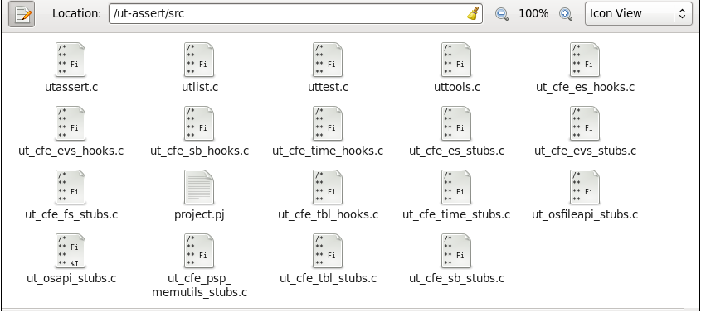
What’s Included in the Library
ut_hooks.c
ut_stubs.c
Contents:
  utassert.c /.h – defines the standard assert function, along with a few related functions
  utlist.c – defines functions to create linked lists, which are used elsewhere in the library
  uttest.c – defines the functions used to add and run test cases
  uttools.c – defines miscellaneous functions that are useful for unit testing
  Removed all “cfe” for Microair, but rewrote one generic “ut_stubs.c and ut_hooks.c” for general purpose use
    ut_cfe_stubs.c – defines the stub functions for a particular cFS component, and supporting functions
    ut_cfe_hooks.c – defines the default hook functions for a particular cFS component

Slide 6
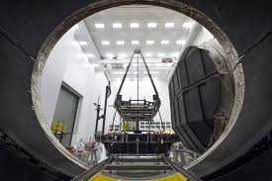
Test Structure

Slide 7
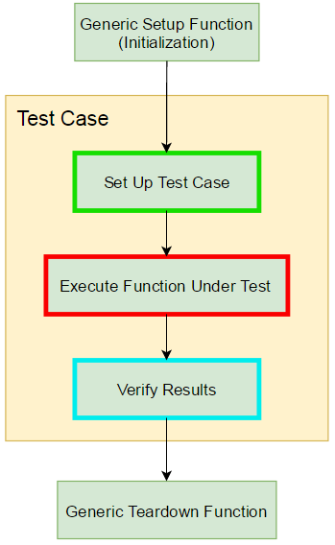
Test Structure: Test Case Flowchart

Slide 8
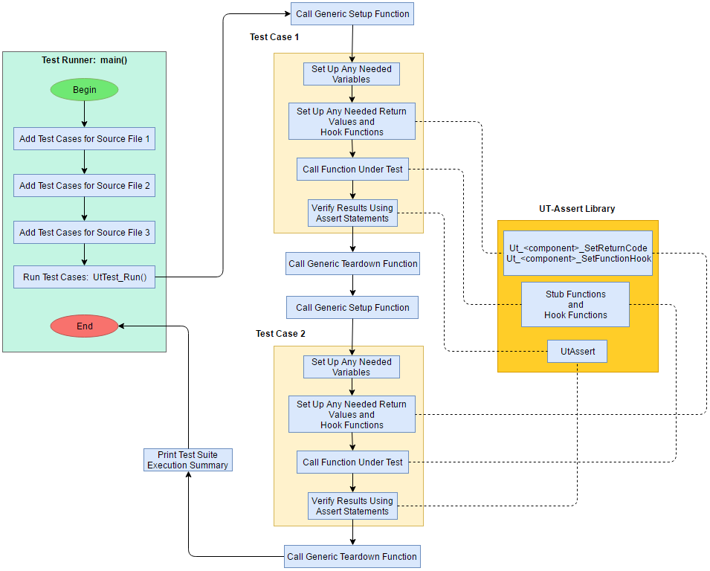
Test Structure: Full Flowchart

Slide 9
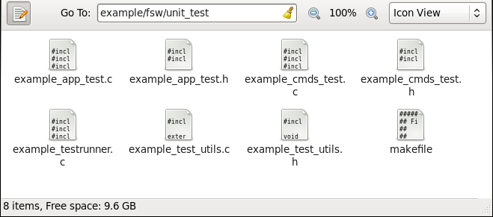
Test Structure: Required Test Files
For the example application:
  <source file name>_test.c / .h: defines the unit test cases for all functions in a particular source file
  <app name>_test_utils.c / .h: defines miscellaneous test functions (Setup, Teardown, etc)
  <app name>_testrunner.c: defines the main function, which adds all test cases and runs them
  makefile: standard makefile functionality

Slide 10
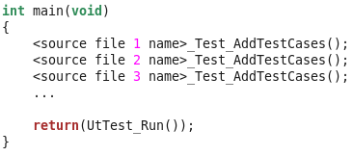
Test Structure: Test Runner
<project>_testrunner.c
  Top-level function for running the entire test suite
    Adds all test cases for each source file under test
    Runs all test cases

Slide 11
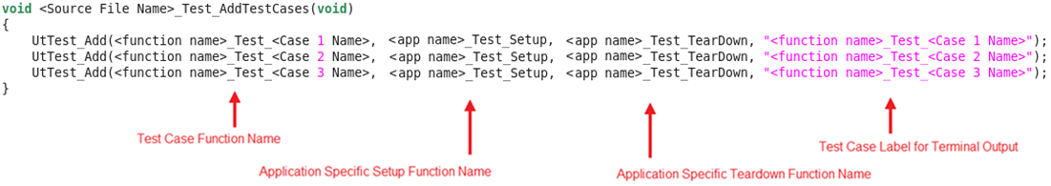
Test Structure: Test Runner
Adding Test Cases
  Test runner adds all test cases for a particular file via <source file name>_Test_AddTestCases
    Written by the user
  <source file name>_Test_AddTestCases adds each case via UT-Assert function UtTest_Add

Slide 12
Test Structure: Test Runner
After all test cases are added, Ut-Assert library function “UtTest_Run” is called
  Called only once, which executes all test cases
  For each of the previously-added test cases:
    Prints “Running Test: <test case name>”
    Calls specified Setup function
    Calls test case function
      Each assert in test case will print “PASS: <assert label>” or “FAIL: <assert label>”
      If assert passes, increments count of passed asserts; else increments count of failed asserts
    Increments count of tests executed
    Calls specified Teardown function
  Prints “Tests Executed: <count of executed tests>”
  Prints “Assert Pass Count: <count of passed asserts>”
  Prints “Assert Fail Count: <count of failed asserts>”

Slide 13
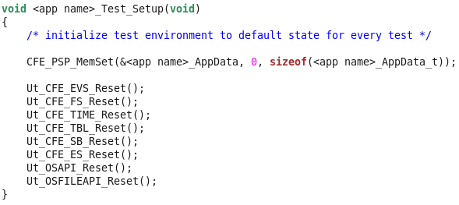
Test Structure: Test Runner
Setup Function:
  A single user-written initialization function automatically called before each test case is run
    Initializes to default conditions before each test case
    Same function called for every test case in the test suite
Teardown Function:
  Similar to the Setup Function, but called AFTER each test case
Both are defined in ***_test_utils.c
Example setup function: (for Microair, this is likely only setting global variables, or other global conditions)

Slide 14
Test Structure: Test Cases
Written by the user
Tests a single condition, branch of code, etc, using assert statements
Each test tests functionality (i.e. correct return value) and one code coverage path of each function in an application, one at a time
Only needs to test the designated section of code
  Sub-functions are tested in separate test cases

Slide 15

Writing Test Cases

Slide 16
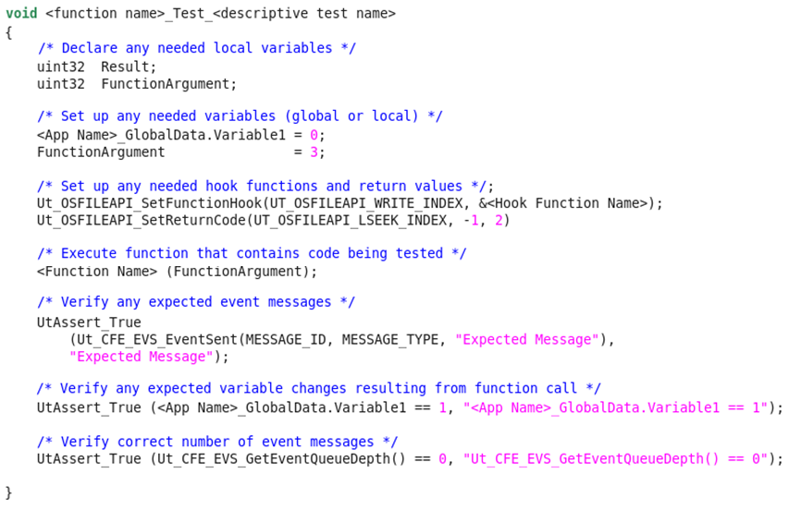
Writing Test Cases: Basic Structure
Set Up Test Case
Execute Function Under Test
Verify Results

Slide 17
Writing Test Cases: Assert Statements
An assert statement evaluates whether a condition is true or false and returns PASS or FAIL.
For frequently-used groups of assert statements, it is recommended to write custom function
  Any code changes would then only need to be changed in one place
Multiple types of assert are defined via macros
  Only one assert type is necessary (UtAssert_True), but others can be useful

Slide 18
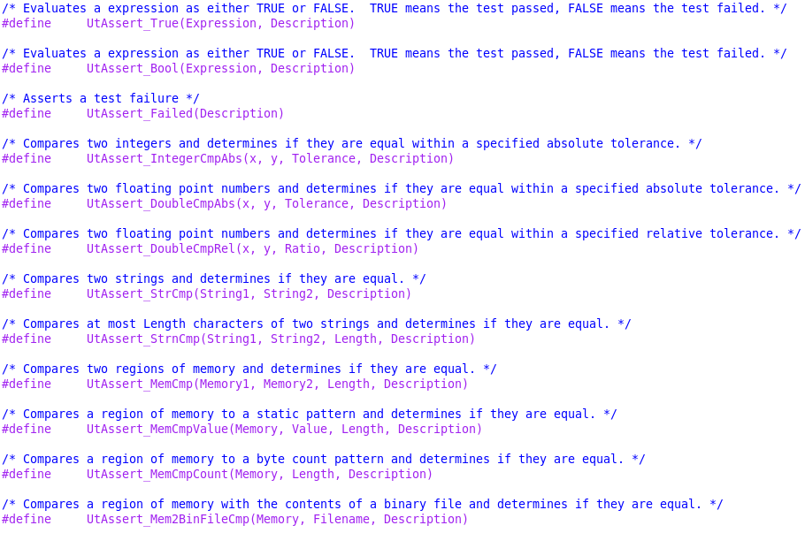
Writing Test Cases: Assert Statements
Other assert types:

Slide 19
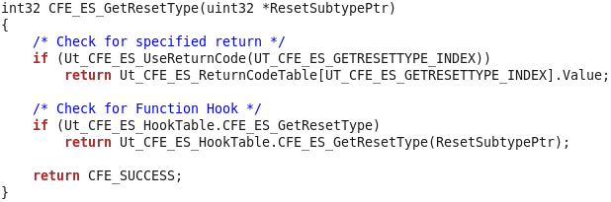
Writing Test Cases: Stub Functions
Stub functions replace calls to “real” functions corresponding cFS API library function
Stub Function Example (will be shown during demo):
Setup Example:
  To set stub function to return a custom return value:
    Ut_CFE_ES_SetReturnCode(UT_CFE_ES_GETRESETTYPE_INDEX, Value, CallCountToReturnOn);
  To set stub function to call a custom hook function:
    Ut_CFE_ES_SetFunctionHook(UT_CFE_ES_GETRESETTYPE_INDEX, &HookFunctionName);

Slide 20
Writing Test Cases: Hook Functions
A hook function can be written and set to be called by a stub function
  Replaces a UT-Assert function’s code with alternate code for testing purposes
    If no hook function, UT-Assert function only calls empty stub, which only returns a value
UT-Assert library includes default hook functions for some cFS API functions
  Defined in files ending in “hooks.h” / “hooks.c”
  General sample “ut_hooks.h” and “ut_hooks.c” files were created for general use for non-cFS applications for use with their own libraries and API
  These will be demonstrated

Slide 21
Makefile
(Updated, made and checked)
Quickest way to create new makefile:
  1.) Copy from UT-Assert Example or another CFS App UT-Assert Unit Test
  2.) Modify the makefile to be correct for new test suite
Contents of makefile:
  Paths to source files
  Object files to compile from source files
  Name of test runner executable
  Compiler and linker options
  Rules to make targets (all, run, gcov, clean)
    Note: there may be issues running gcov built code in a debugger
  C compiler rule

Slide 22
Test Suite Execution
1.) Open a terminal window in the unit_test directory
2.) “make clean”
3.) “make” (runs default “make all”)
4.) “make run” (or ./<test suite executable name>)
- This will show the unit test results, “Pass” or “Fail” for each test (will demo)
5.) “make gcov” (optional – gets gcov code coverage results)
- This will show the results of gcov and MC/DC coverage (will demo)
  Search for “not covered” in .gcov file, will tell you which outcomes are not MC/DC tested
  Goal: “Condition outcomes covered:100.00%”
Note: these assume makefile is properly set up

Slide 23
Test Output
Test results and gcov coverage results are displayed in terminal window
  User should manually copy to output log: <projectname>_test_log.txt
Line-by-line code coverage detailed in .gcov files generated when gcov is run
It is recommended that a README file be written, using a previous test README file as an guideline
Output example:
  Running Test: FM_InvokeChildTask_Test_WriteIndexEqualsQueueDepth
  PASS: FM_GlobalData.ChildWriteIndex == 0
  PASS: FM_GlobalData.ChildQueueCount == 1
  PASS: Ut_CFE_EVS_GetEventQueueDepth() == 0
  Running Test: FM_AppendPathSep_Test
  PASS: strncmp(Directory, 'directory/', OS_MAX_PATH_LEN) == 0
  PASS: Ut_CFE_EVS_GetEventQueueDepth() == 0
  Tests Executed: 178
  Assert Pass Count: 679
  Assert Fail Count: 0
<<<<< Note below is OLD gcov output, prior to MC/DC being added – demo will show new output, but it it similar>>
  gcov: '../src/fm_tbl.c' 100.00% 52
  gcov: '../src/fm_child.c' 100.00% 481
  gcov: '../src/fm_app.c' 100.00% 120
  gcov: '../src/fm_cmds.c' 100.00% 285
  gcov: '../src/fm_cmd_utils.c' 100.00% 174

Slide 24
Additional Features
Preprocessor Macro Options
  UT_VERBOSE (default = true)
    Determines whether or not to print less-important messages to the terminal
  UT_VERBOSE_TEST_NAME (default = false)
    If UT_VERBOSE = false, determines whether or not to print test names
  UT_STOP_ON_ASSERT_FAILURE (default = false)
    Determines whether or not to stop execution of entire test suit if a single test case fails
UtPrintf:
  Like printf, but only prints if UT_VERBOSE = true
UtSprintf:
  Like sprintf, but returns the string instead of using pointer

Slide 25
Walkthrough: Example File cFS Application
Test
Source files to walk through:
  File folder
  example_file1.c
  example_testrunner.c
  example_test_utils.c
  example_file1_test.c
  .gcov output
  ut_stubs.c
    (shows default return “true” and specified return code)
  ut_hooks.c
    Shows alternate function
  Makefile
  Bonus:
  Doc_format.h

Slide 26

(not applicable to Microair)
Walkthrough: Actual cFS Application Test Suite
Source files to walk through:
  fm_testrunner.c
  fm_test_utils.c
  fm_app_test.c
  fm_child_test.c
  fm_cmds_test.c
  fm_cmd_utils_test.c
Other files to walk through:
  fm_test_log.txt
  README.txt

Slide 27

Useful Tips
For frequently-used groups of assert statements, it is recommended to write custom function
  Any code changes would then only need to be changed in one place
Use existing UT-Assert projects as reference for new projects
If gcov causes problems when running in debugger:
  Change makefile:
    Replace lines for GCOV_COPT and GCOV_LOPT with:
      ENABLE_GCOV = FALSE
      ifeq ($(ENABLE_GCOV), TRUE)
      GCOV_COPT = -fprofile-arcs -ftest-coverage -pg -p
      GCOV_LOPT = -pg -p -fprofile-arcs -ftest-coverage -lgcov
      endif

Slide 28


How to Get the UT-Assert Library
Integrity 2010 FSW_TOOLS repository
Code 582 FSB Document Repository
  https://fsb.gsfc.nasa.gov/CFS/
    Under Baselined Documents / Releases
cFS NASA wide community Babelfish git repository
Sourceforge
  https://sourceforge.net/projects/cfs-ut-assert/
  LEP: this is where I got the copy I am using for this demo

